Slide 1

Chapter 7 Error Handling

Slide 2
Error types
User inputs (forms, uploaded files, biometric)
Policy and security rules
Network and medium
Undefined states (declared in our own code)
Notes:
Examples: IoException, 404 not found, Validation errors

Slide 3
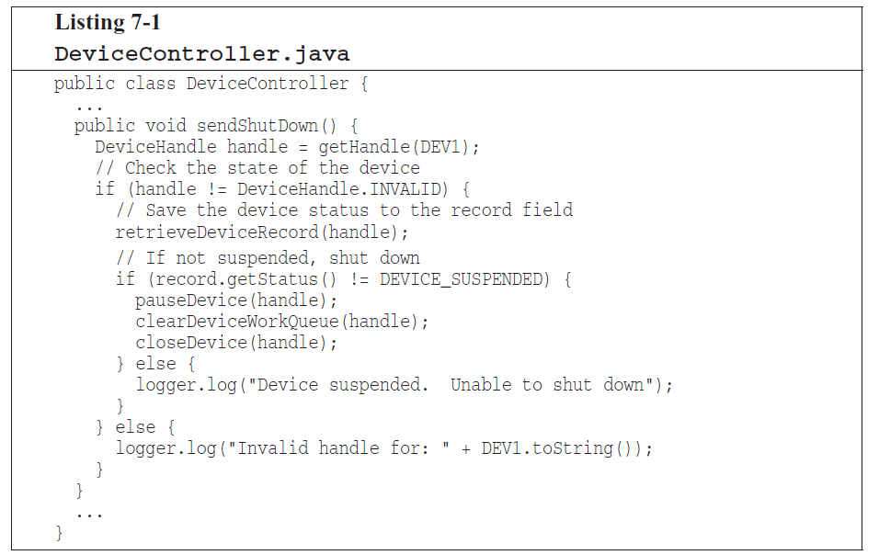
Use Exceptions Rather Than Return Codes
Notes:
Caller must deal with error code immediately.
Unfortunately, it’s easy to forget

Slide 4
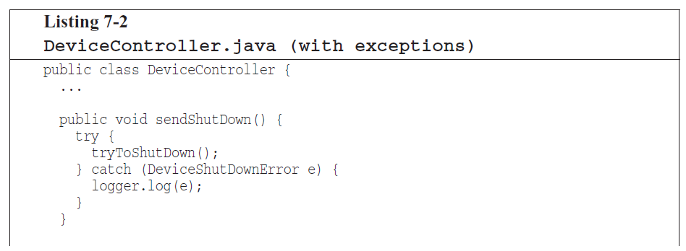
Use Exceptions Rather Than Return Codes
Notes:
Don’t be afraid to throw exception

Slide 5
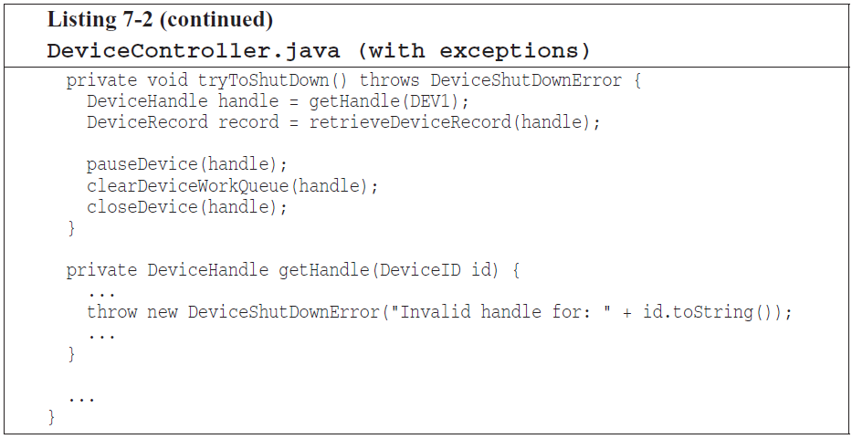
Use Exceptions Rather Than Return Codes
Notes:
Fail in development phase instead of production

Slide 6
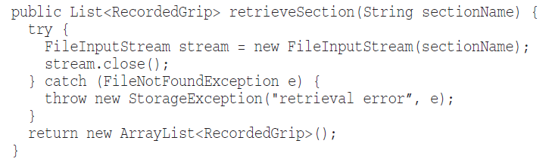
Try-Catch-Finally Statement
Try blocks are like transaction
Your catch has to leave your program in consistent state, no matter what happens in the try
Notes:
Now you can safely write your code after stream is created

Slide 7
Use Unchecked Exceptions
What is checked exception?
Checked exception is a type of exception which force the caller to write try/catch block, otherwise we would have compiler error.
What are the costs?
Open/Closed principle violation
Break encapsulation
Notes:
- force any change in low level code to affect higher levels.
- Encapsulation is broken because all functions in the path of a throw must know about details of that low-level exception.

Slide 8
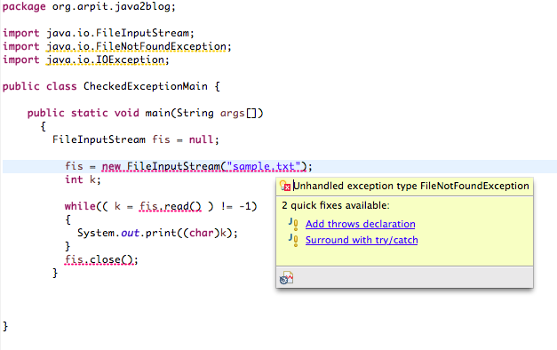
Use Unchecked Exceptions

Slide 9
Provide Context with Exceptions
Stack trace is not enough
Provide informative message with your exception
Mention the operation that failed and the type of failure
Give user of your code a solution
Notes:
Proper error (saber fun)

Slide 10
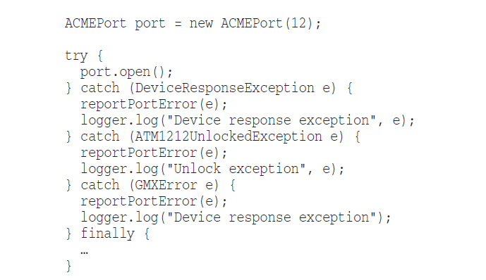
Define Exception Classes in Terms of a Caller’s Needs
Notes:
Here is a third-party api we are using all over our codebase

Slide 11
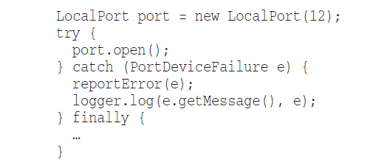
Define Exception Classes in Terms of a Caller’s Needs

Slide 12
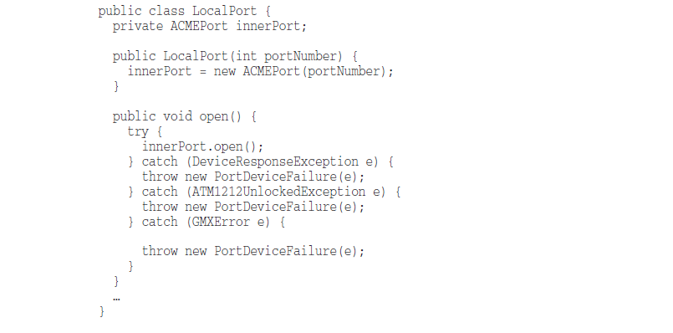
Define Exception Classes in Terms of a Caller’s Needs

Slide 13
Define Exception Classes in Terms of a Caller’s Needs
Benefits
minimize your dependencies upon it: You can choose to move to a different library in the future without much penalty
makes it easier to mock out third-party calls when you are testing your own code.
You can define an API that you feel comfortable with

Slide 14
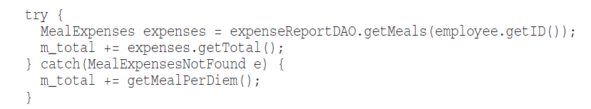

Define the normal flow
What if we write it this way?
Notes:
This is called the SPECIAL CASE PATTERN
You create a class or configure an object so that it handles a special case for you. When you do, the client code doesn’t have
to deal with exceptional behavior. That behavior is encapsulated in the special case object

Slide 15
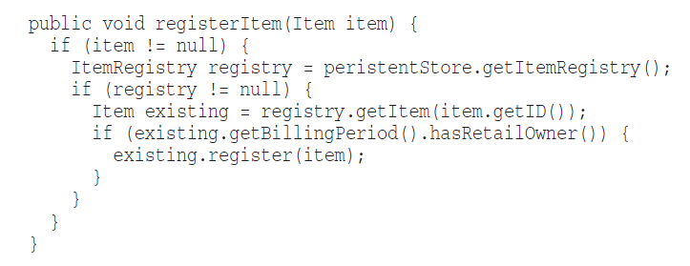
Don’t return NULL
What is this??
Notes:
What if persistenStore is null ?!

Slide 16
Don’t return NULL
How to avoid returning null?
Default values
Empty list
Throw exception
Validate inputs
Don’t Overcomplicate Things

Slide 17
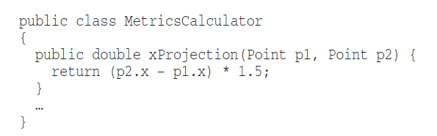
Don’t pass NULL
What happens when someone passes null as an argument?
Notes:
Returning null from methods is bad, but passing null into methods is worse

Slide 18
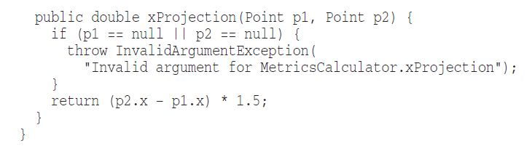
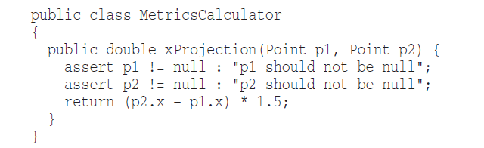
Don’t pass NULL
Solution?

Slide 19
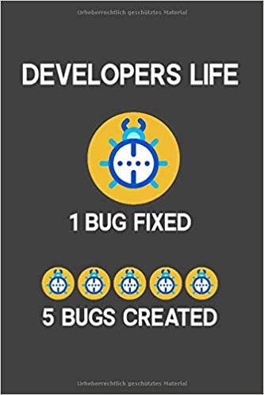
Vocabulary: Regression
A kind of bug which occurs after we change code
it can be same bug repeated again
or new bugs created from changes

Slide 20
Tool: Issue tracker
Issue tracking is the process of recording customer complaints and problems so that they can be resolved in an organized fashion.
Bugs
Feature request
Help wanted
Proposal
…

Slide 21
Thank You!

